Slide 1
Nuclear Fuel Performance
NE-533
Spring 2025

Slide 2
Last time
Radial hydrides can form in used fuel after drying, and reduce ductility much more than circumferential hydrides
DHC is a phenomenon based upon increased solubility of hydrogen in the high tensile stress around a crack tip
Have the ability to predict hydrogen pickup in oxidized Zr cladding
Defined RIA/LOCA
RIA is often caused in PWR/BWR by control rod ejection/drop
RIA is a fast event, can lead to PCMI failures, ballooning, and in worst case scenarios, fuel dispersal
Effects of RIA depend on burnup include fission gas, FCMI, oxide layer, hydrides, cladding pressure, etc

Slide 3
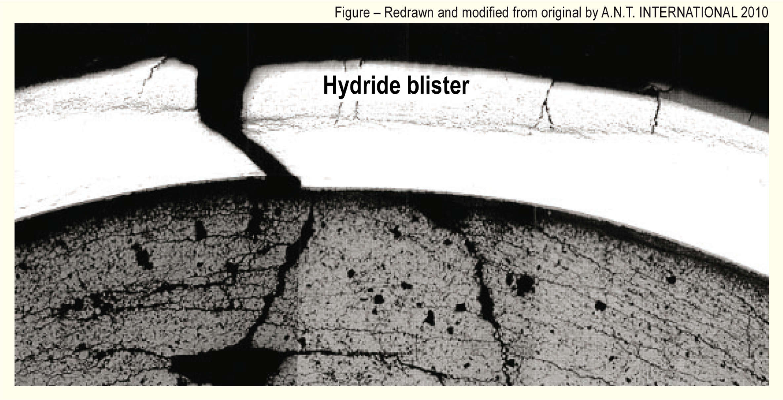
Cladding Response
PCMI failures results from the fuel pushing out on the cladding, causing it to break

Slide 4
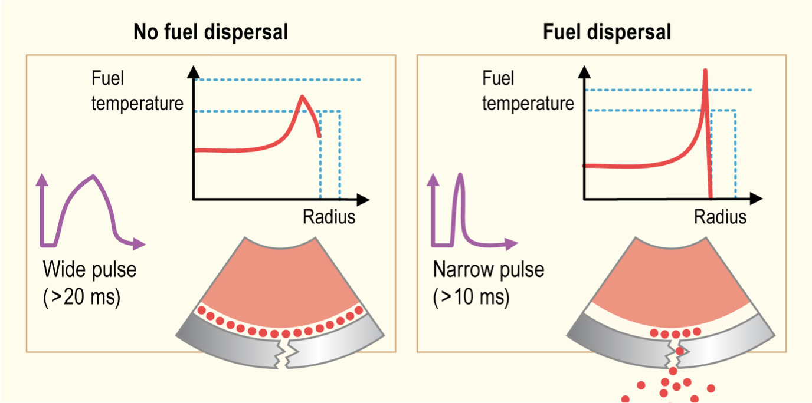
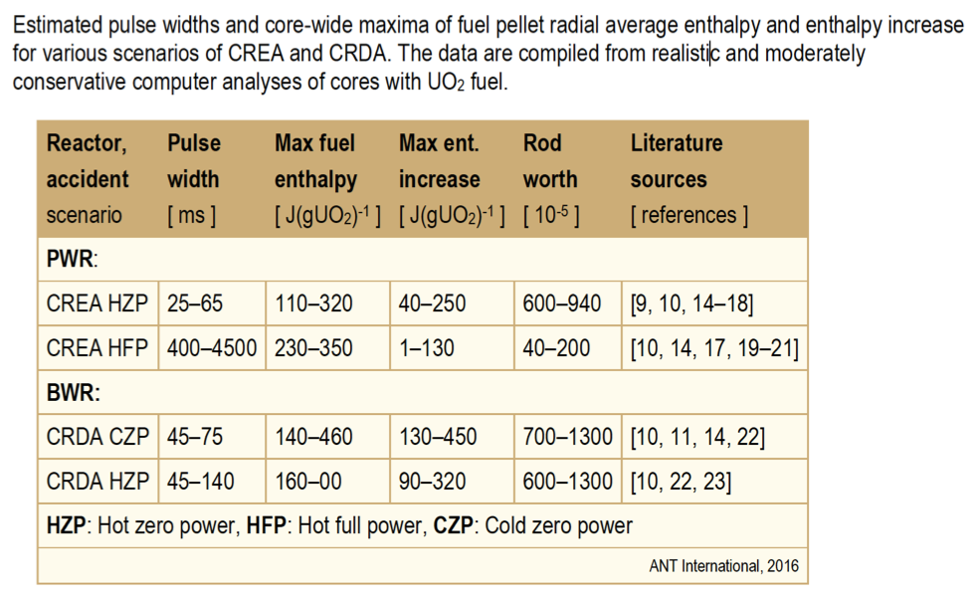
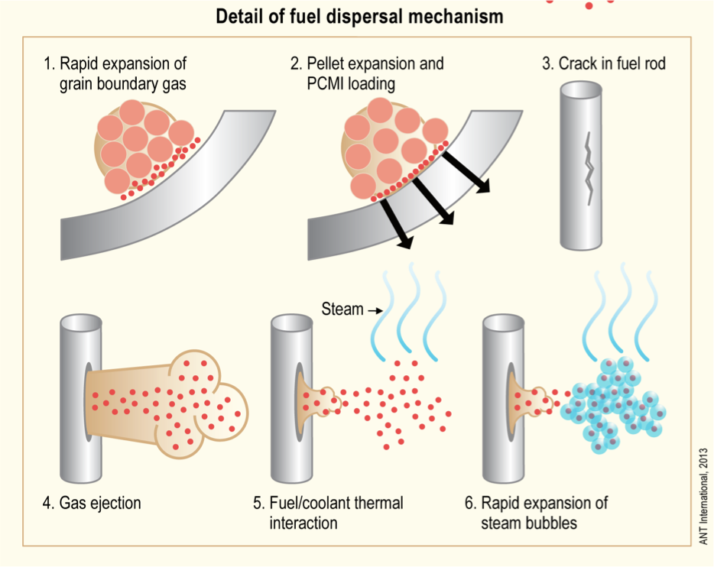
Pulse Width
The amplitude and width of the power pulse can have dramatic impacts on the effects of the RIA
Pulse is typically defined by FWHM, and by total energy deposition (integration of pulse)
More rapid temperature spike is more damaging
Reactor state and type during typical accident scenarios determine pulse width

Slide 5
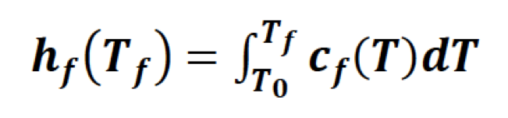
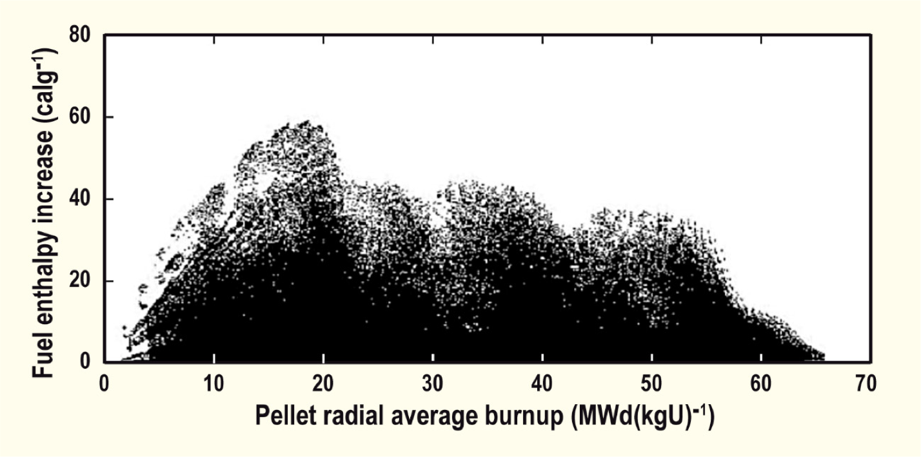
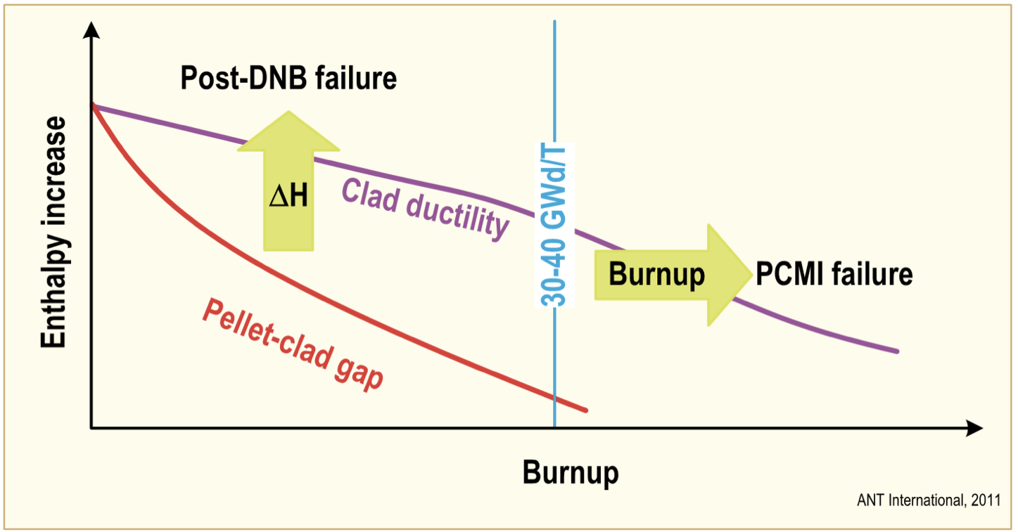
Effect of Burnup
Fuel rod damage correlates with the peak value of fuel pellet specific enthalpy; the higher the enthalpy increase, the more extensive is the damage
Fuel enthalpy increases are higher in fresh fuel
Cladding failure occurs at lower fuel enthalpy increases for irradiated than for fresh fuel rods, thus, the susceptibility to failure increases with increasing fuel burnup
The degree of cladding waterside corrosion is very important for survivability of preirradiated fuel rods
Safety criteria are defined in terms of limits on the radially averaged fuel pellet specific enthalpy, or the increase of this property during the accident

Slide 6
RIA Summary
Reactivity insertion accident
In PWR/BWR often initiated by control rod ejection/drop
Shorter pulses have greater impact than longer pulses (given same energy deposition)
Fast accident, causing temperature spike, pellet expansion, gas expansion
Can lead to PCMI or DNB failure events, and in worst case fuel ejection
Effects of RIA depend on burnup
fission gas, PCMI, oxide layer, hydrides, cladding pressure, etc.

Slide 7
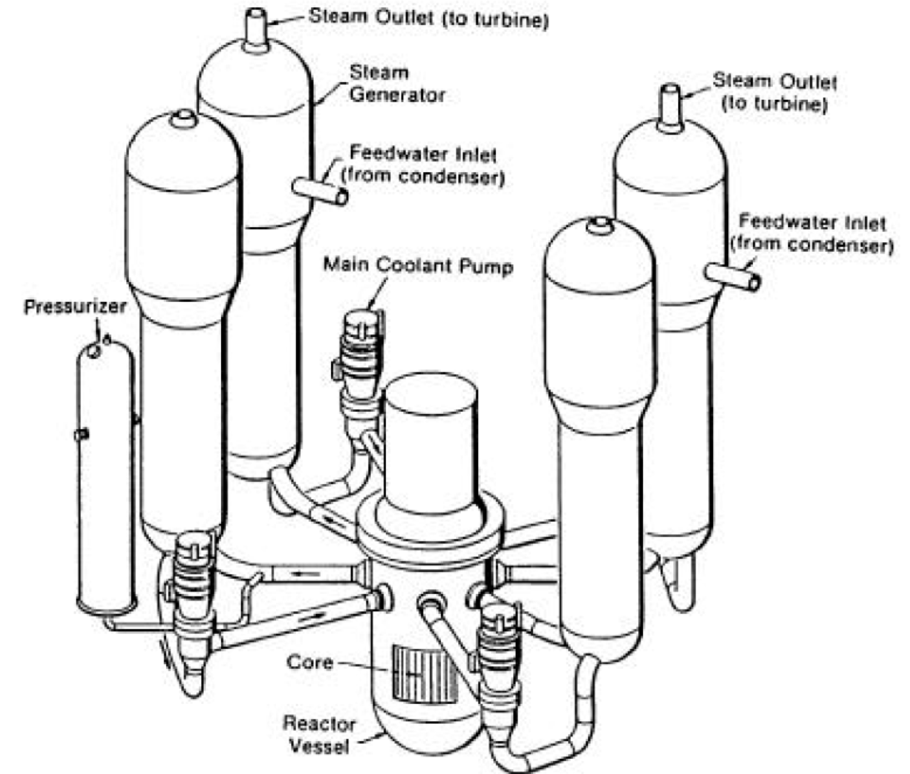
Loss of Coolant Accident (LOCA)
Design basis accident for LWRs
In a LOCA, the coolant flow is reduced or lost altogether (e.g., coolant pipe break)
When this occurs, pressure drops, engaging the emergency shutdown system
SCRAMS the reactor, stopping the fission chain reaction
The reactor water is expelled into the containment
The emergency core cooling system (ECCS) begins to remove heat
Safety requirement is to maintain a coolable geometry

Slide 8
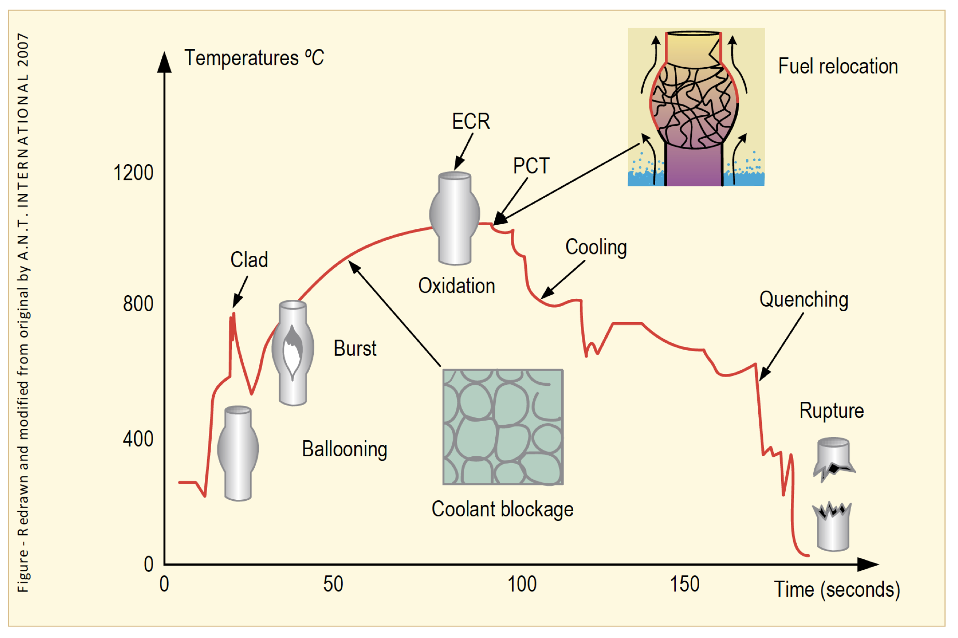
Loss of Coolant Accident (LOCA)
The average temperature of the reactor continues to rise due to radioactive decay in the fuel and the lower cooling
Decrease in coolant pressure and increase in internal pressure causes large plastic deformation
Causes the cladding to balloon out and potentially burst
Ballooning blocks coolant flow
Cladding burst is significantly impacted by oxidation and hydride embrittlement

Slide 9
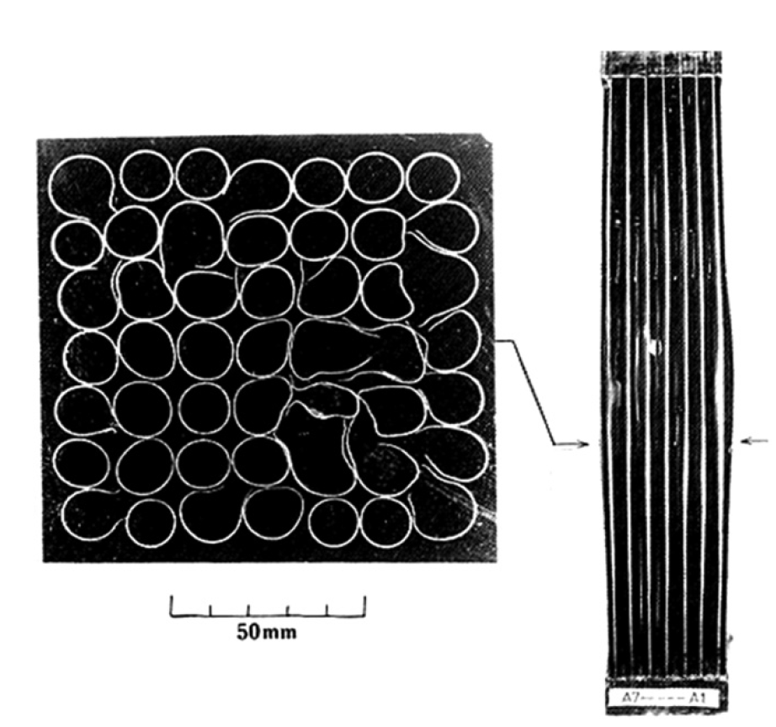
LOCA Blockages
During the heat-up, the cladding plastically deforms (balloon and rupture) due to decrease of the system pressure outside the fuel rod and decrease in cladding strength - rod pressure becomes higher than the system pressure
Creep strength of Zircaloy rapidly falls with the temperature
The beta phase has different creep properties than the alpha phase, and alpha+beta phase can exhibit superplastic behavior
Large plastic deformation of the cladding in the radial direction results in blockage of the coolant channels between fuel rods

Slide 10
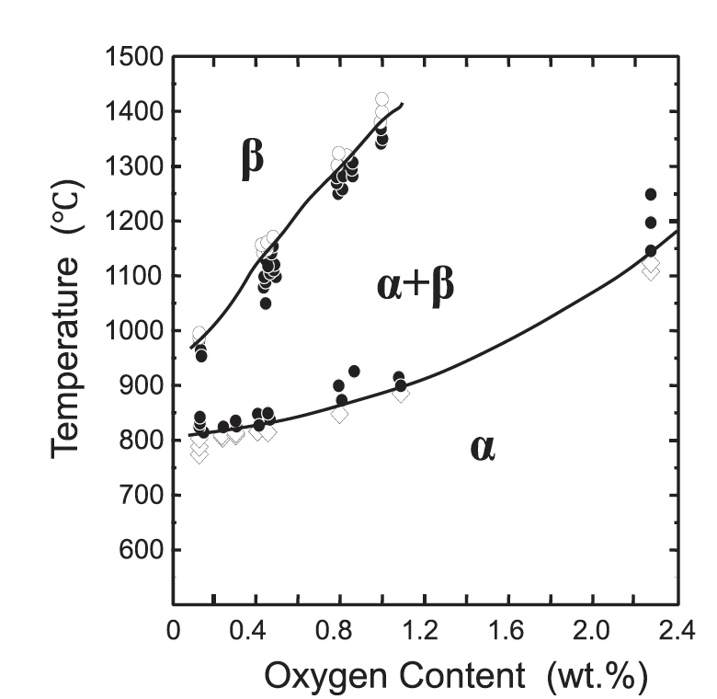
LOCA Phase Transformations
The phase structure of Zircaloy transforms from alpha to alpha+beta above about 800C, and to beta above about 1000C
The cladding reacts with steam or coolant at high temperatures, and an oxide (ZrO2) layer is formed on the surface of the cladding
In addition, absorbed oxygen stabilizes the alpha-phase and a layer of alpha-phase with a high content of oxygen begins to grow on the beta-phase, and the beta-phase becomes less ductile by the oxygen absorption

Slide 11
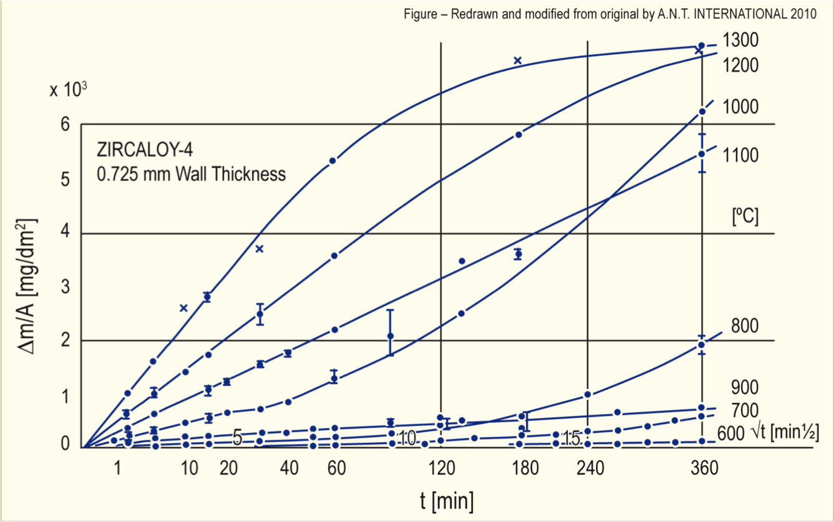
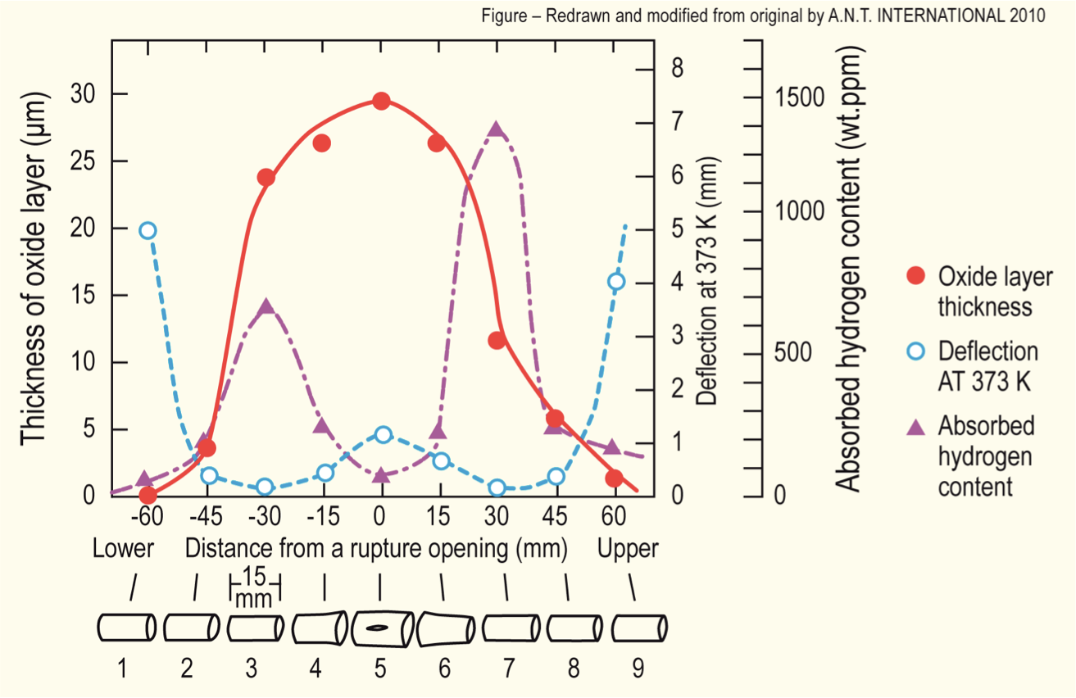
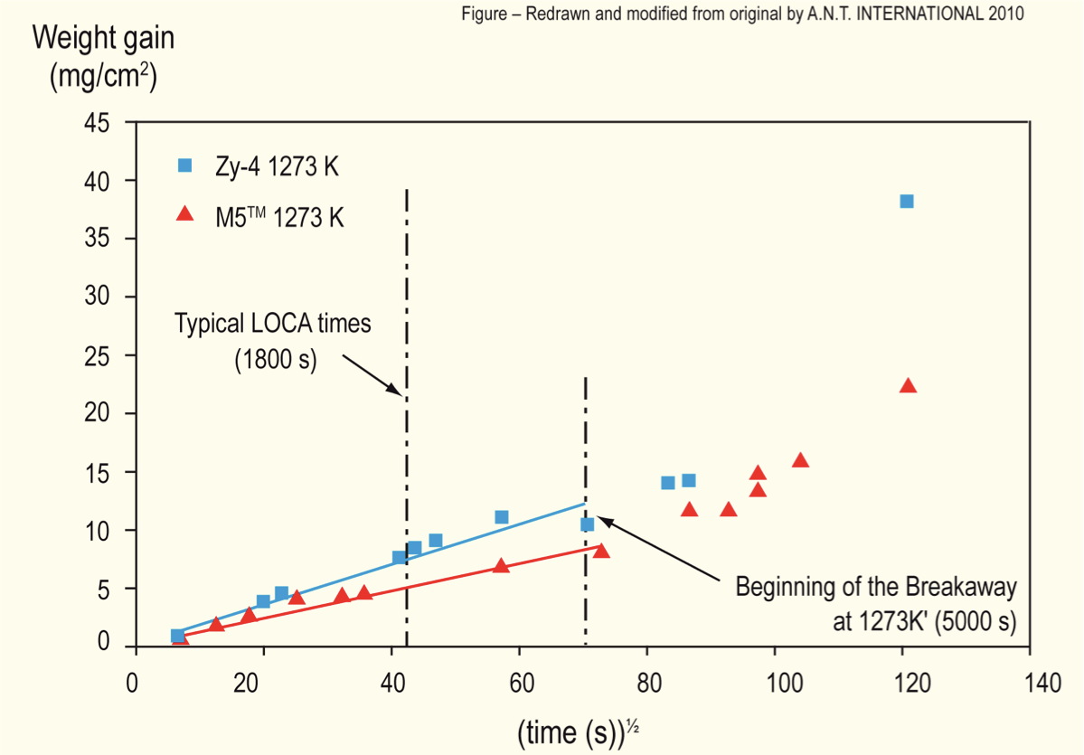
LOCA Oxidation
Oxidation significantly increases at high temperatures
Due to exothermic heat generated during oxidation of the cladding, at high enough temperatures, the rate of oxidation is so high that the heat can no longer be dissipated by cooling, leading to run-away oxidation (Three Mile Island)
Breakaway oxidation results in increased hydrogen pickup, embrittling the cladding
Excess H generation can lead to H2 gas accumulation inside the containment

Slide 12
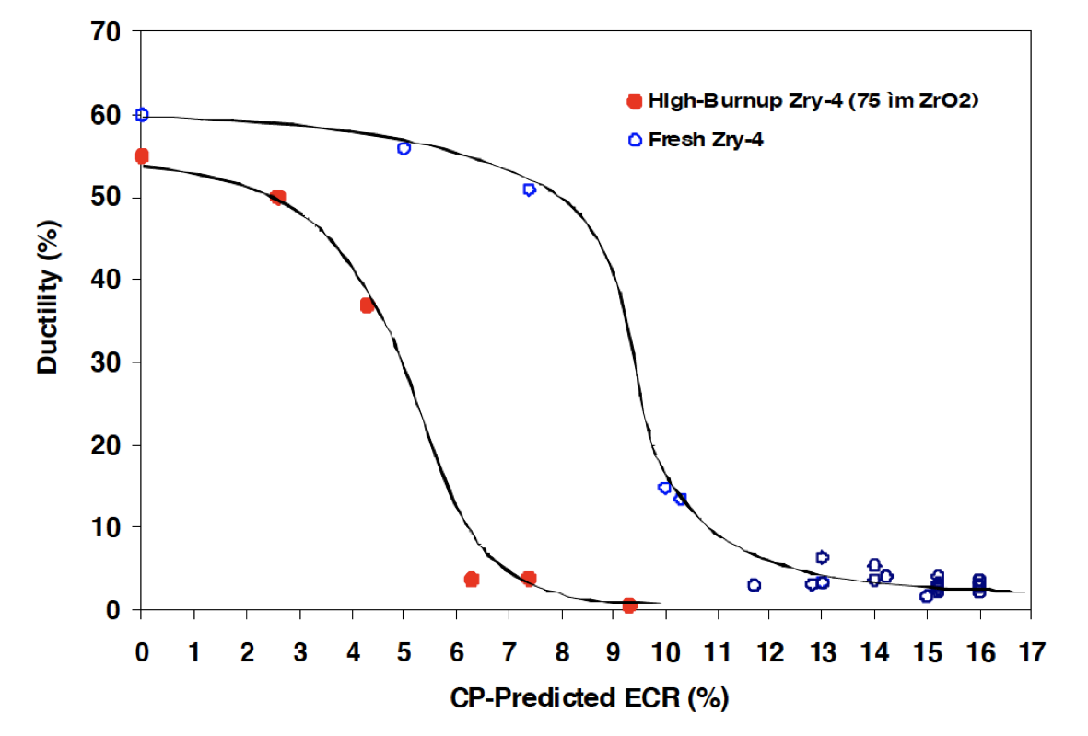
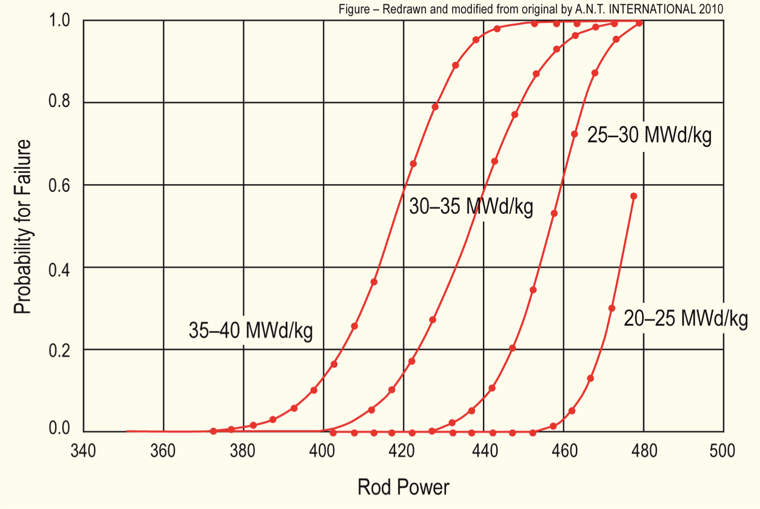
Effect of Burnup
At high burnup, ductility of the cladding is significantly reduced due to existing corrosion, hydrogen embrittlement, and irradiation hardening
This leads to higher likelihood of failure for higher burnup conditions
Alloys with lower corrosion could potentially go to higher burnup, and retain ductility under a LOCA
Similar to RIA (but more slow), temperature increases can lead to gas bubble pressure increases, fuel fragmentation, increased thermal expansion, PCMI, etc.

Slide 13
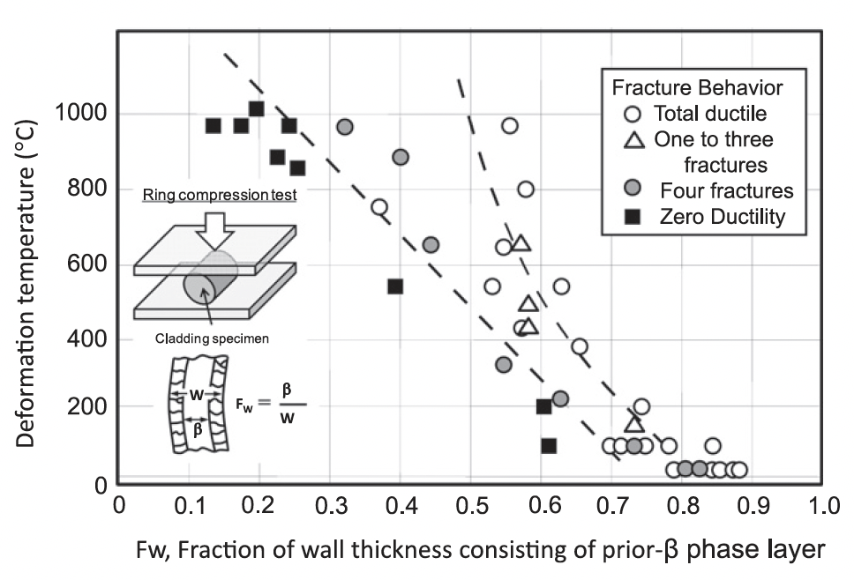
Embrittlement
On rewetting of the cladding by ECCS water, a thermal shock by quenching is induced
If the cladding is severely oxidized at temperatures above 1000C, the embrittled cladding may be fragmented by the quenching
The ductility decreases as the fraction of the unoxidized layer decreases
There are limits imposed on the amount of oxidation to limit brittle failure on ECCS quenching

Slide 14
LOCA Summary
LOCA, pipe break resulting in loss of coolant/flow
Increase in temperature, decrease in coolant pressure
High temperatures lead to increased oxidation, producing additional hydrogen, this can lead to embrittlement, ballooning, and burst of the cladding
LOCA occurs over a timescale of minutes, much longer than a RIA

Slide 15
Accident tolerant fuels

Slide 16
Mitigation through design
Accident tolerant fuels aim to provide additional coping time
The time required for the water to boil away
The time required for the fuel to melt
The time required for the molten fuel to breach the primary pressure boundary
Fuels with enhanced tolerance can tolerate loss of active cooling for a considerably longer period, while maintaining or improving performance during normal operation
Can also widen the existing safety margin for nuclear plants and improve nuclear plant performance with fuel that lasts longer

Slide 17
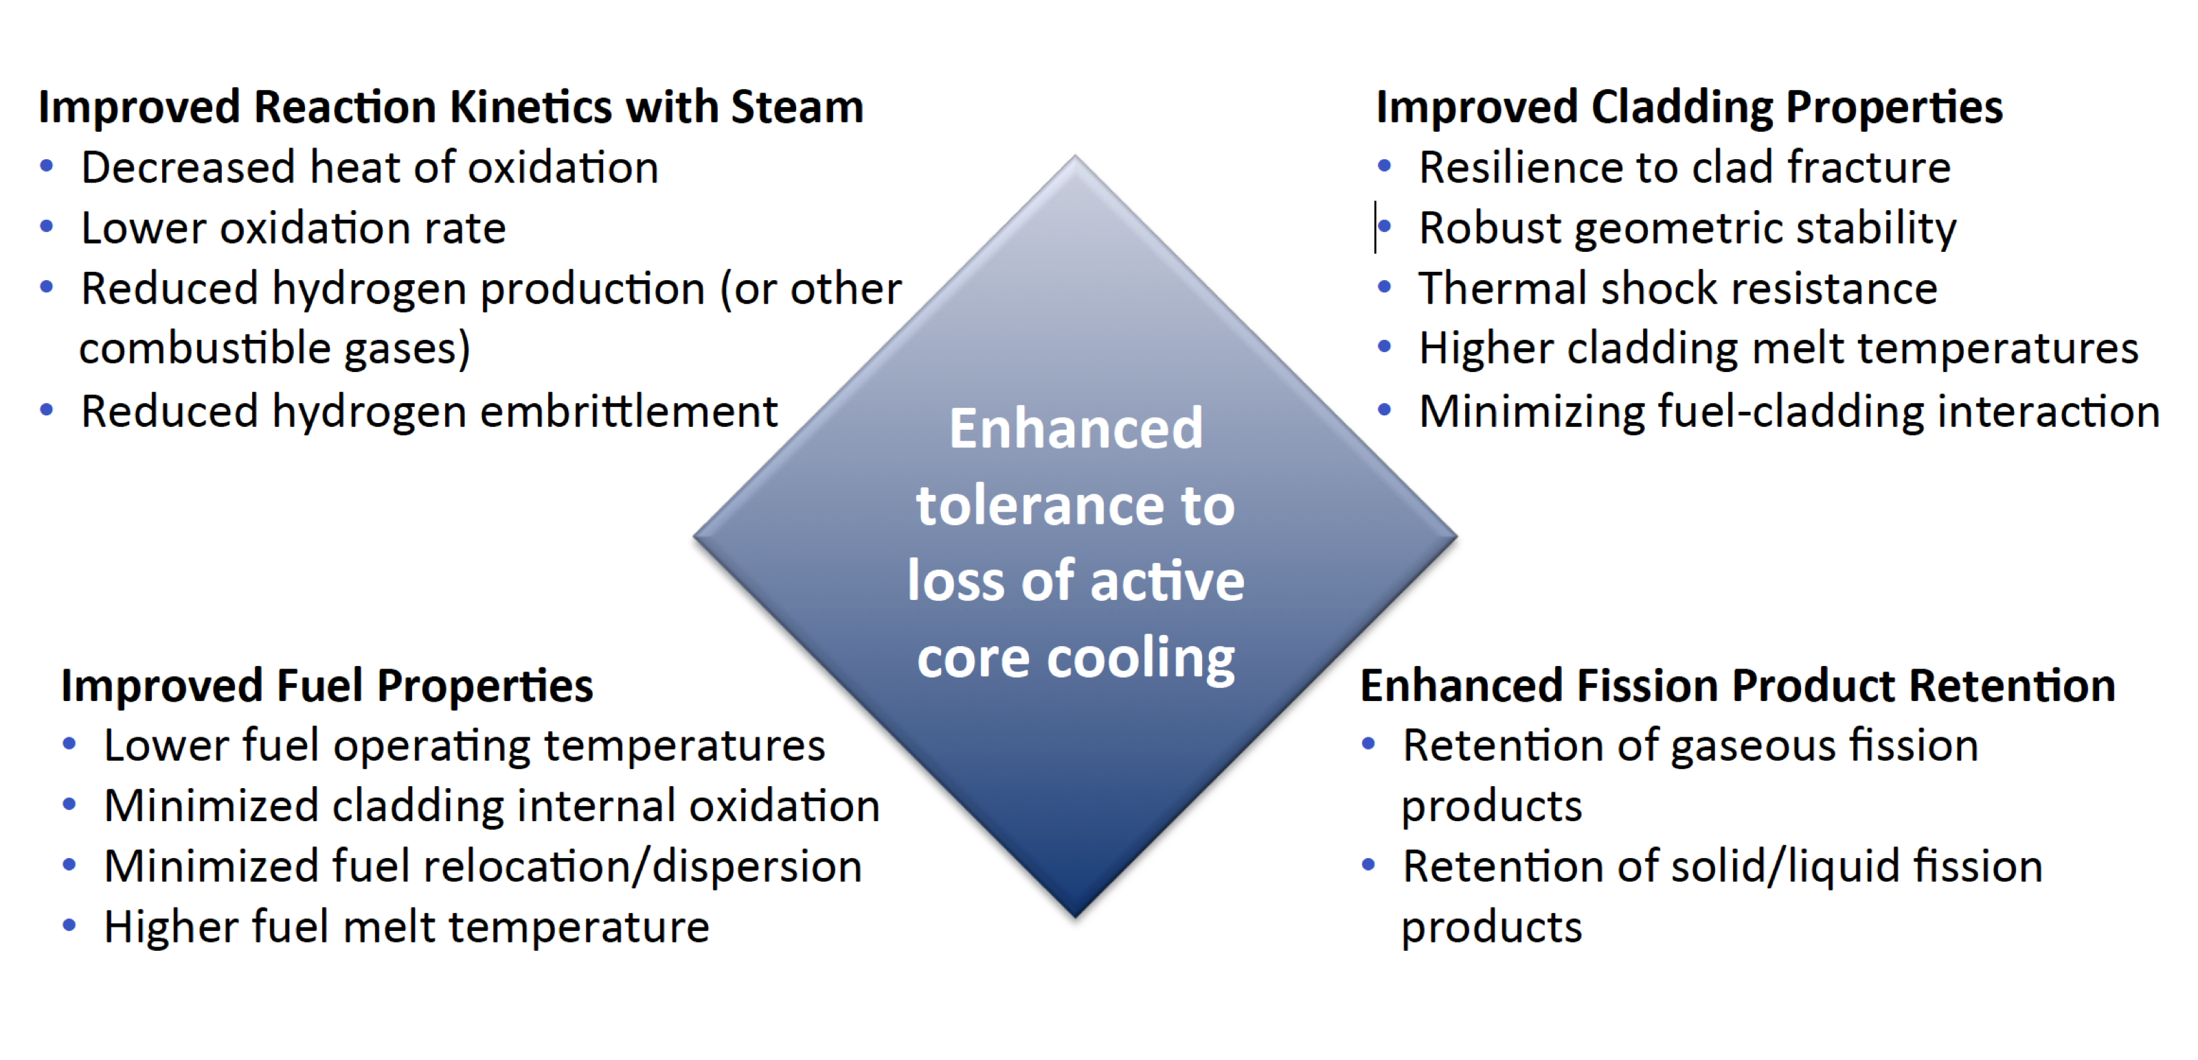
Accident Tolerance

Slide 18
Categories of ATF Concepts
ATF can be divided into three main categories
near-term ATF improvements
novel fuel and cladding materials
transformational fuel and cladding concepts
Near-term ATF improvements
Zirconium-based cladding
coatings to improve corrosion resistance, especially under high T steam
Urania-based fuel
additives to increase thermal conductivity
These changes are mean to be drop-in replacements that are compatible with existing systems

Slide 19
Categories of ATF Concepts
Novel fuel and cladding materials
U3Si2 fuels
FeCrAl alloys for cladding
Minimal changes needed for LWR designs, could be deployed in 10ish years
Transformational fuel and cladding concepts
fully ceramic micro-encapsulated (FCM) fuels
SiC/SiC composite cladding
drastically differ from traditional LWR fuel systems
may require significant modifications to reactor design and operation, but offer potentially large benefits to performance and/or safety

Slide 20
Summary
In loss of coolant accidents (LOCA), the fuel and cladding experience
increases temperature
decrease in coolant pressure
High temperatures lead to increased oxidation, producing additional hydrogen
This can lead to embrittlement, ballooning, and burst of the cladding
Fuel relocation and fission gas release in the fuel
Accident tolerant fuel includes different fuel and cladding materials to increase time before catastrophic behavior during an accident

Slide 21
Accident Safety Limits

Slide 22
Accident Safety Limits
Fuel cladding temperature cannot exceed 1204 C
Local cladding oxidation cannot exceed 17% of wall thickness
H generated must be less than 1% of the total amount that could be generated if all Zr were oxidized
Limits on radiation dose to staff
The response to steam oxidation, specifically on oxide growth and H generation is critical to evaluate safe performance (and potentially qualify new materials)

Slide 23
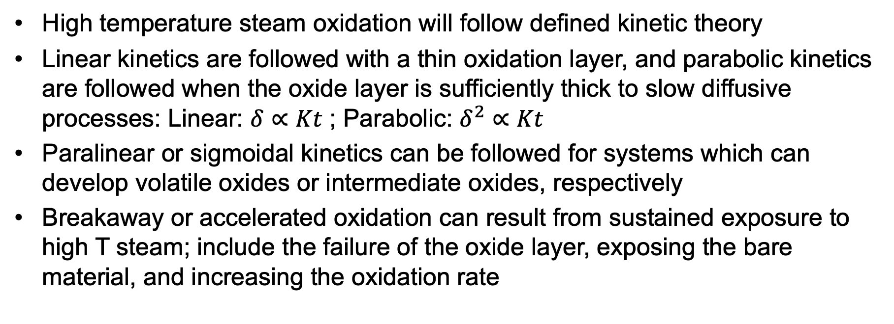
Steam Oxidation
High temperature steam oxidation will follow defined kinetic theory
Linear kinetics are followed with a thin oxidation layer, and parabolic kinetics are followed when the oxide layer is sufficiently thick to slow diffusive processes: Linear: $δ∝Kt$ ; Parabolic: $δ^{2}∝Kt$
Paralinear or sigmoidal kinetics can be followed for systems which can develop volatile oxides or intermediate oxides, respectively
Breakaway or accelerated oxidation can result from sustained exposure to high T steam; include the failure of the oxide layer, exposing the bare material, and increasing the oxidation rate

Slide 24
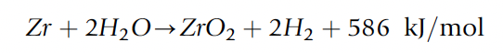
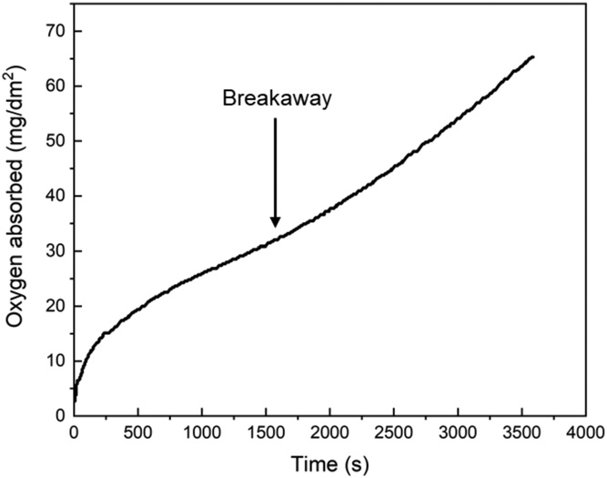
Steam Oxidation
Zr oxidizes with an exothermic reaction
Below 600C, the reaction follow a parabolic or cubic rate law resulting in a uniform and passivating oxide layer
At higher T, the oxide layer can crack due to surface stresses, resulting in breakaway oxidation
At loss of passivation, the oxidation rate can become linear and localized
Zirlo at 1000C in steam

Slide 25
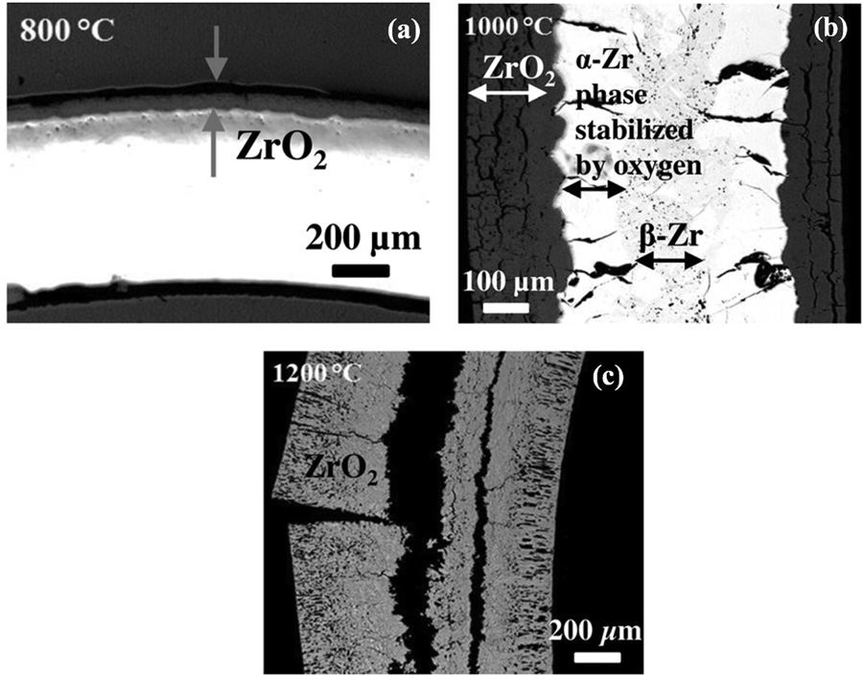
Steam Oxidation
Right is an image of Zircaloy-2 after steam oxidation for 8 hours at a) 800 C, b) 1000 C, c) 1200 C
At 800C, the oxide layer is intact and passivating
At higher temperatures, the oxide layer is thicker and cracked
At 1200C, everything has been oxidized

